Slide 1

Reformer—
Efficient Transformer
3/18/2020
Adil Mounir
Presentation to: CEE 543
March 20, 2018
Adil Mounir
Presentation to: CEE 543
March 20, 2018

Slide 2
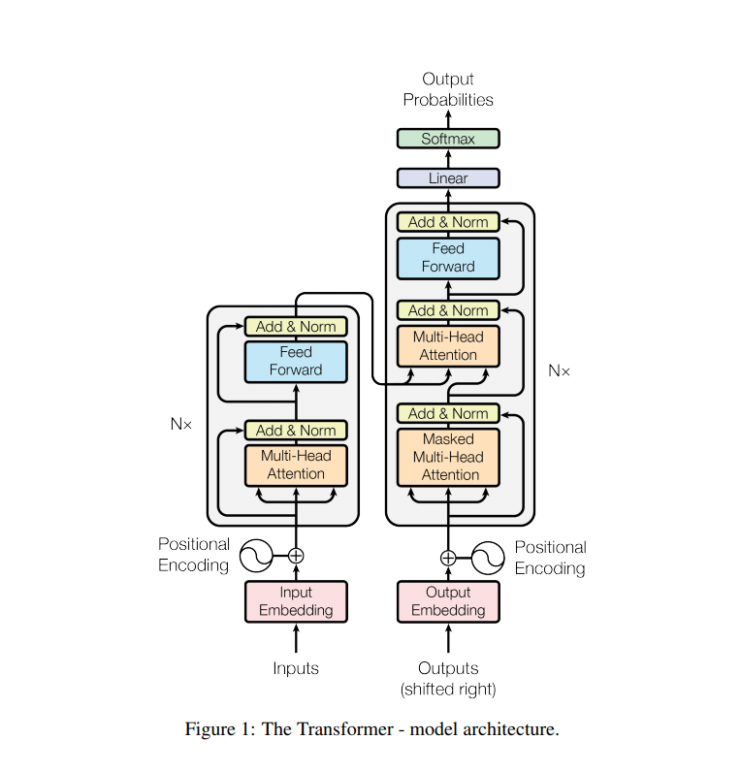
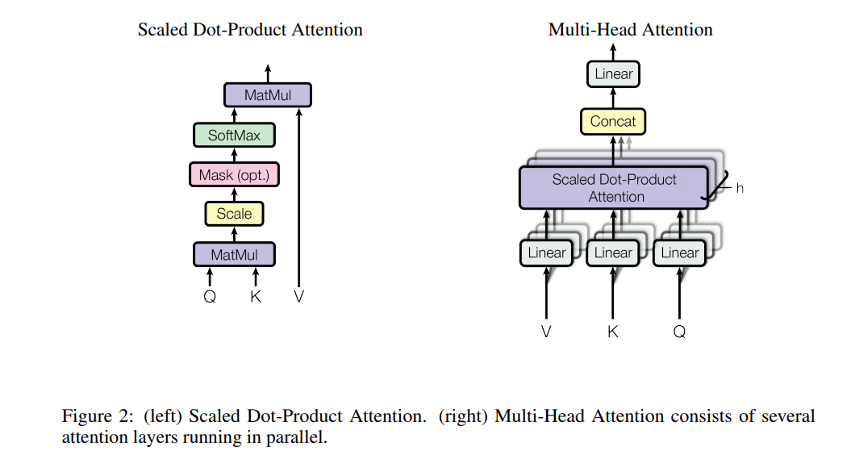
Transformer
The canonical Transformer architecture. Q is the query matrix, K the key matrix and V the value matrix for the inputs
FYI: A helpful illustration of Transformer through visualization is here : http://jalammar.github.io/illustrated-transformer/

Slide 3

Transformer
The attention calculation matrix form:
Computation of the attention function is expensive and mainly dominated by the term of QK^{T}.
Let us assume that Q, K and V all have the shape [batch size; length; dmodel]. The main issue is the term QK^{T} , which has the shape [batch size; length; length]. In the experimental section we train a model on sequences of length 64K – in this case, even at batch-size of 1, this is a 64K64K matrix, which in 32-bit floats wouldtake 16GB of memory. This is impractical and has hindered the use of the Transformer for long sequences.
Is there an efficient method?

Slide 4
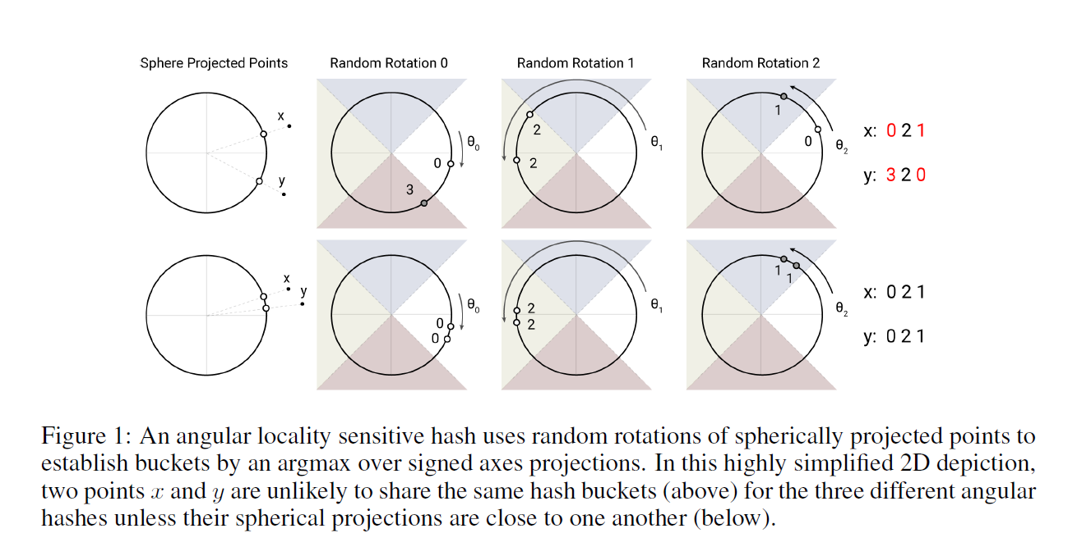
Reformer- Efficient Transformer
Reformer has the same architecture as Transformer model. But using a different way calculate the attention function.
Shared Q, K:
Reformer assumes that matrix Q = K.
Locality Sensitive Hashing (LSH):
Since the SoftMax function is dominated the largest terms, instead of calculating the entire K matrix to each qi vector in Q we could only consider a small subset of (say 32 or 64) closest key vectors to qi in K.
Illustration of LSH

Slide 5
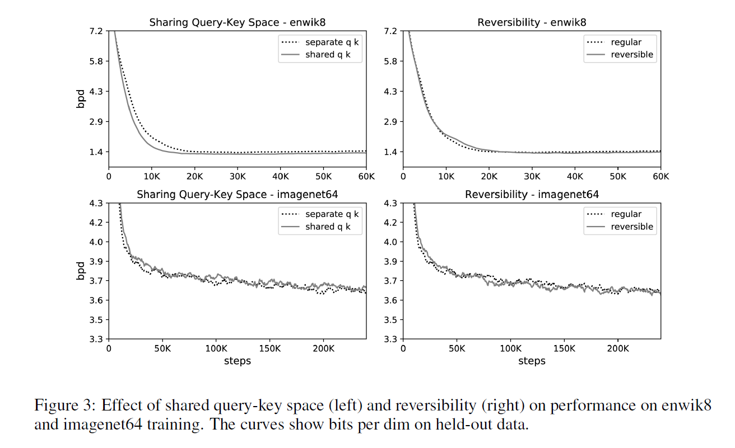
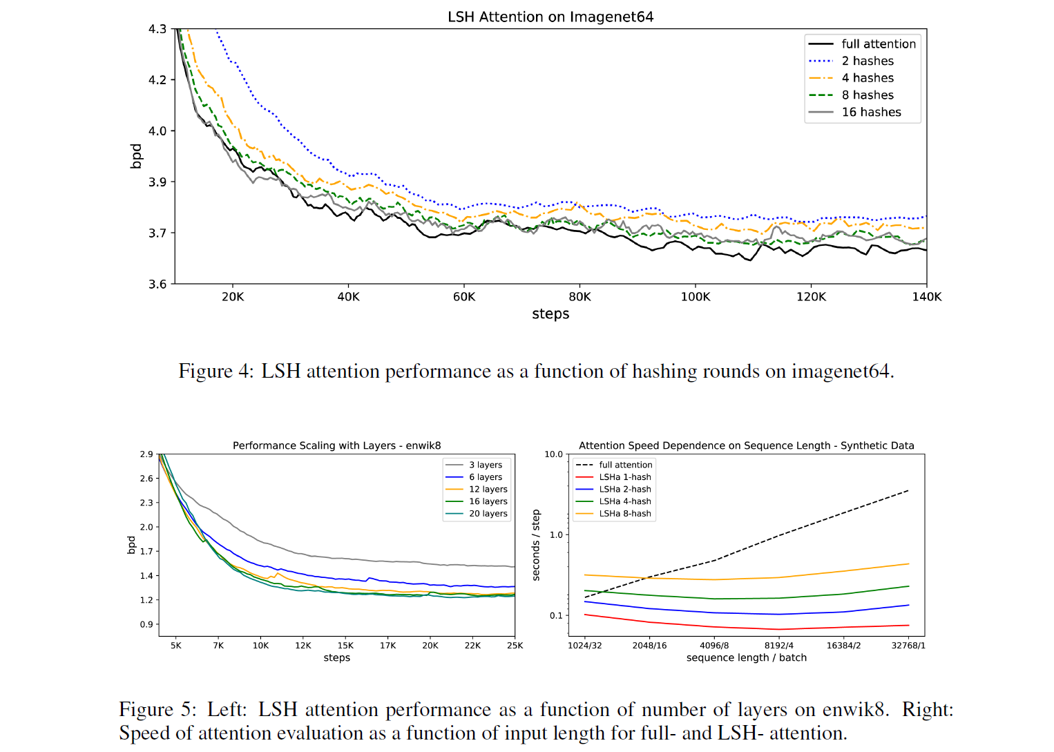
Results compared with Transformer
Conclusion:
We can see that shared Q and K method doesn’t influence the model performance significantly.
The LSH hashed attention gives very close performance to Transformer when it has 8 or 16 hashes. And the more hashes the close the results will be.

Slide 6
References
Ashish Vaswani, Noam Shazeer, Niki Parmar, Jakob Uszkoreit, Llion Jones, Aidan N Gomez, Lukasz Kaiser, and Illia Polosukhin. 2017. Attention is all you need. In Advances in Neural Information Processing Systems, pages 6000–6010.
Nikita Kitaev, Lukasz Kaiser, and Anselm Levskaya. Reformer: The efficient transformer. In ICLR, 2020.

